Slide 1
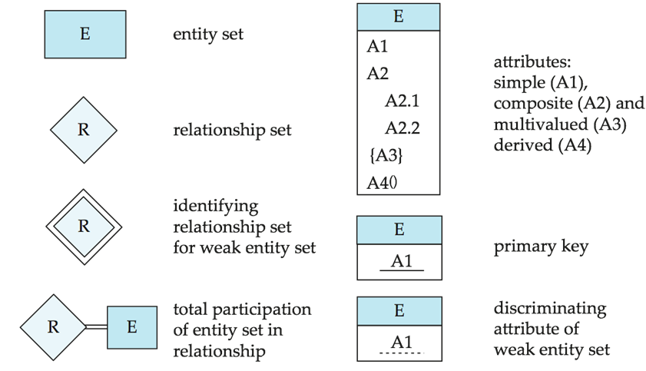
Summary of Symbols Used in E-R Notation

Slide 2
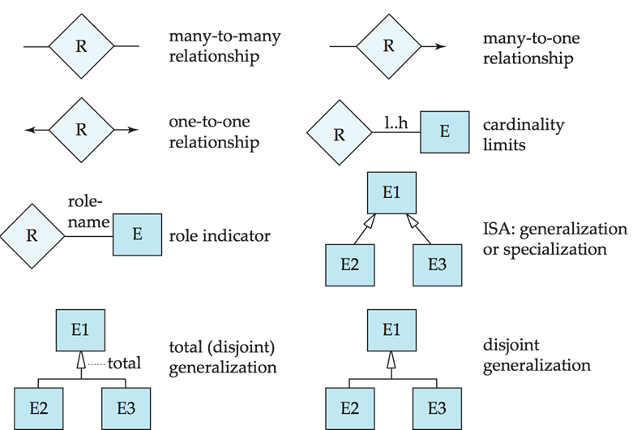
Symbols Used in E-R Notation (Cont.)

Slide 3
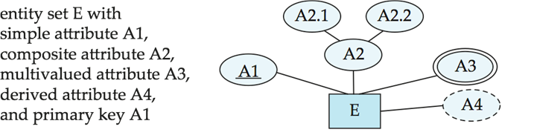
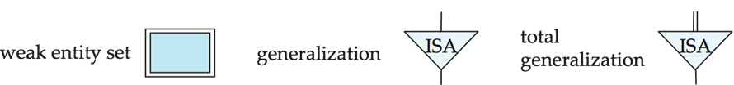
Alternative ER Notations
Chen, IDE1FX, …

Slide 4
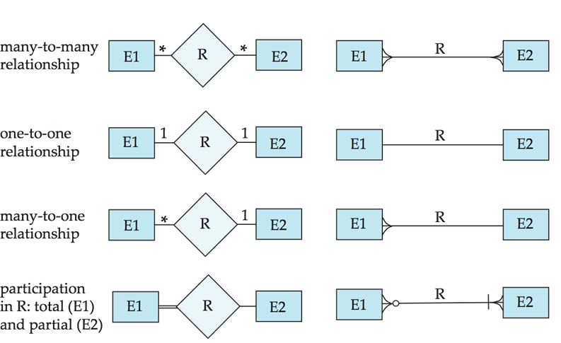
Alternative ER Notations
Chen
IDE1FX (Crows feet notation)

